Slide 1
Anomaly detection in graphs - past, present and future.
Leman Akoglu CMU
Mary McGlohon Google
Christos Faloutsos CMU

Slide 2
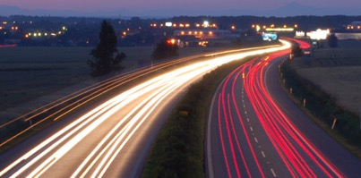
Roadmap
Introduction – Motivation
Past
Present
Future

Slide 3
Roadmap
Introduction – Motivation
Past
Present
Future
Q1) definition?
Q2) automation?
Q3) next steps?

Slide 4
Future – parting thoughts
Q1) Definition of anomaly?
A) “… strange/remote/unlikely, wrt our biases/priors”
Q2) can we automate it?
A) no, but: look for better models/biases/priors
Q3) next steps?
A) cross-disciplinarity -> new+better models

Slide 5
Future – parting thoughts
Q1) Definition of anomaly?
A) “… strange/remote/unlikely, wrt our biases/priors”
Q2) can we automate it?
A) no, but: look for better models/biases/priors
Q3) next steps?
A) cross-disciplinarity -> new+better models

Slide 6
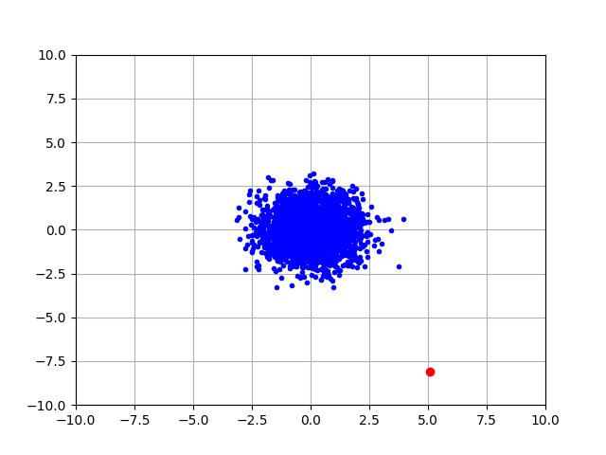
Q1) definition
“an observation which deviates so much from the other observations as to arouse suspicions that it was generated by a different mechanism”
D. M. Hawkins. Identification of outliers, volume 11. Springer, 1980.

Slide 7
Q1) definition
‘deviation from the common rule’
https://www.merriam-webster.com/dictionary/anomaly

Slide 8
Q1) definition
‘deviation from the common rule’
https://www.merriam-webster.com/dictionary/anomaly
But: Who spots the rules?

Slide 9
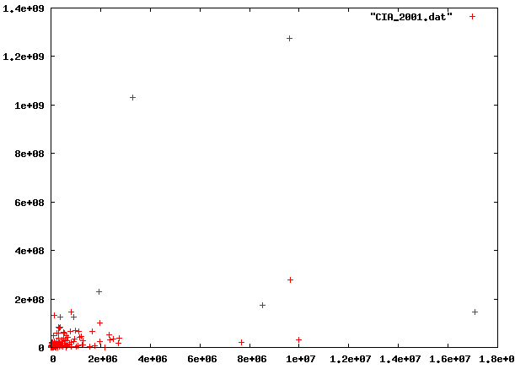
Q1: rules?

Slide 10
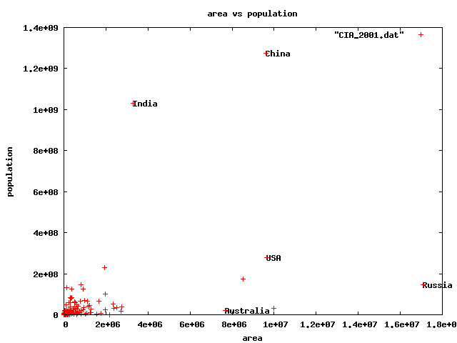
Q1) rules?
🇨🇳
🇮🇳
🇱🇷
🇷🇺

Slide 11
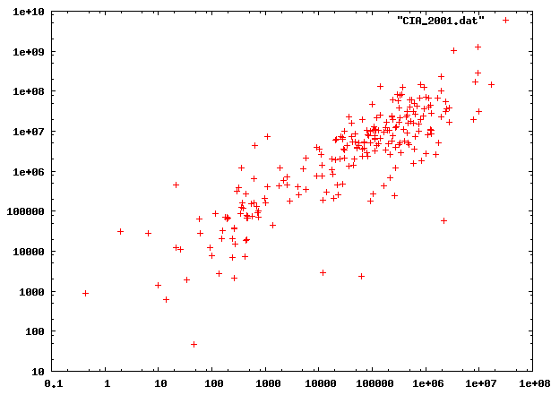
Q1) rules?

Slide 12
Q1) rules?

Slide 13
Q1) rules?

Slide 14
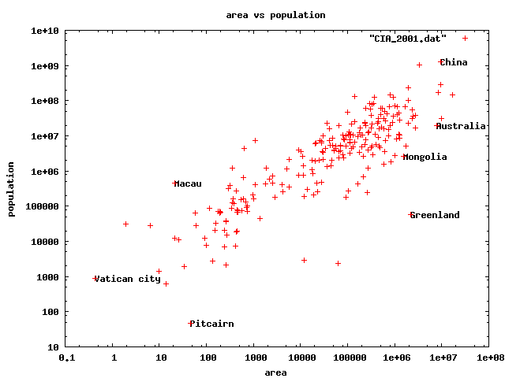
Q1) rules
0.5km²
82 football fields
47 residents(!)

Slide 15
Q1) rules?
47 residents(!)

Slide 16
Q1) definition
‘deviation from the common rule’*
https://www.merriam-webster.com/dictionary/anomaly
* Wrt our rule(s)/biases/axis-scales
But: Who spots the rules?

Slide 17
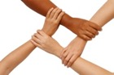
Q1) definition
Patterns anomalies

Slide 18
Roadmap
Introduction – Motivation
Past
Present
Future
Q1) definition?
Q2) automation?
Q3) next steps?

Slide 19
Future – parting thoughts
Q1) Definition of anomaly?
A) “… strange/remote/unlikely, wrt our biases/priors”
Q2) can we automate it?
A) no, but: look for better models/biases/priors
Q3) next steps?
A) cross-disciplinarity -> new+better models

Slide 20
Q2) automation?
Q2.1
patterns
Q2.2
anomalies
compression

Slide 21
Q2) automation?
Q2.1
patterns
Q2.2
anomalies
compression

Slide 22
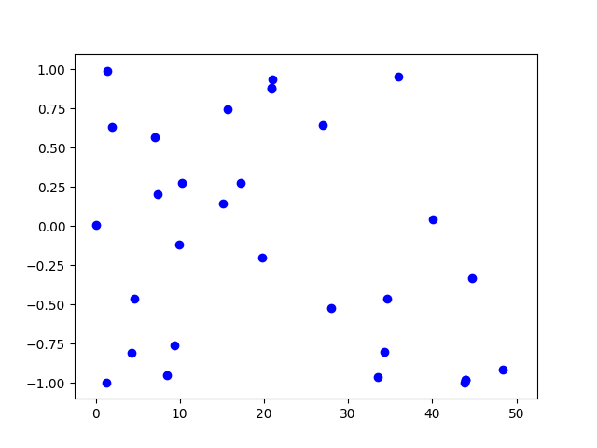
Q2.1) patterns <-> anomalies
Random?

Slide 23
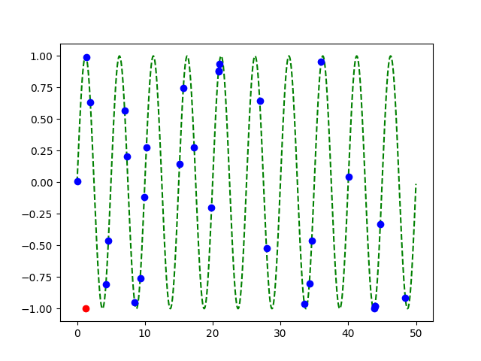
Q2.1) patterns <-> anomalies
Random?
Pattern!
+
Anomaly!

Slide 24
Q2) automation?
✓
Q2.1
patterns
Q2.2
anomalies
compression

Slide 25
Q2.2) patterns <-> compression
2 int per point
1 int per point
(plus 3 parm’s of sinusoid,
plus 2 int for outlier)

Slide 26
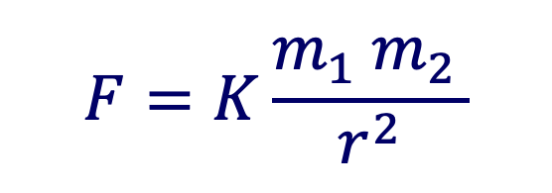
Q2.2) patterns <-> compression
Compression: @heart of science, e.g.:
$$F=K\frac{m_{1} m_{2 }}{r^{2}}$$
⬅️ Kepler ⬅️

Slide 27
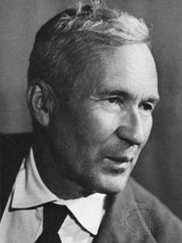
… compression is undecidable!
Theorem*: for an arbitrary string x, computing its Kolmogorov complexity K(x) is undecidable
A.N. Kolmogorov
(*) E.g., [T. M. Cover and J. A. Thomas. Elements of Information Theory. John Wiley and Sons,1991, section 7.7]

Slide 28
… compression is undecidable!
Theorem*: for an arbitrary string x, computing its Kolmogorov complexity K(x) is undecidable
EVEN WORSE
than NP-hard!
A.N. Kolmogorov
(*) E.g., [T. M. Cover and J. A. Thomas. Elements of Information Theory. John Wiley and Sons,1991, section 7.7]

Slide 29
… compression is undecidable!
…which means there will be a chance to discover better data mining tools / models / patterns
-> job security ☺
-> job satisfaction ☺

Slide 30
Roadmap
Introduction – Motivation
Past
Present
Future
Q1) definition?
Q2) automation?
Q3) next steps?

Slide 31
Future – parting thoughts
Q1) Definition of anomaly?
A) “… strange/remote/unlikely, wrt our biases/priors”
Q2) can we automate it?
A) no, but: look for better models/biases/priors
Q3) next steps?
A) cross-disciplinarity -> new+better models

Slide 32
Examples of models
Fractals / self-similarity (Norway)
Logistic parabola (flies; covid)
Lotka-Volterra
Lorenz attractor (laser / synthetic )
Van der Pol / FitzHugh-Nagumo

Slide 33
Q3.1) models

Slide 34
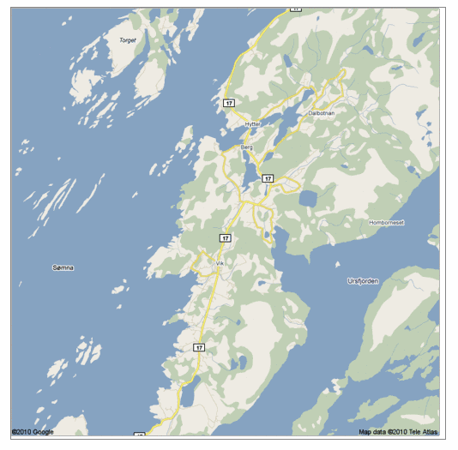
Q: Any pattern?

Slide 35
A: self similar!

Slide 36
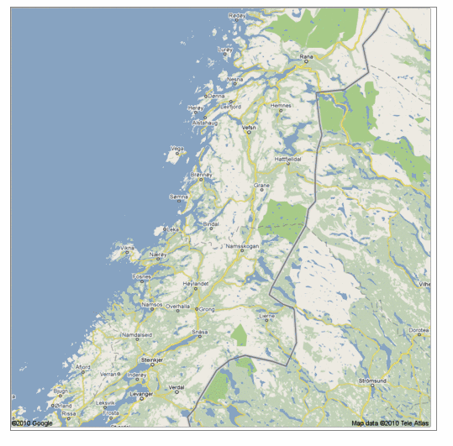
Real, self similar dataset

Slide 37
Real, self similar dataset

Slide 38
Real, self similar dataset

Slide 39
Real, self similar dataset

Slide 40
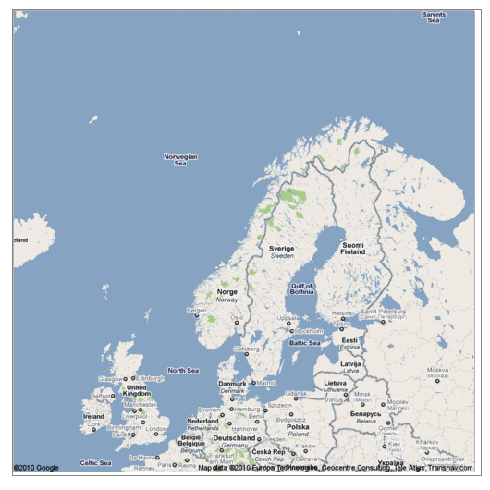
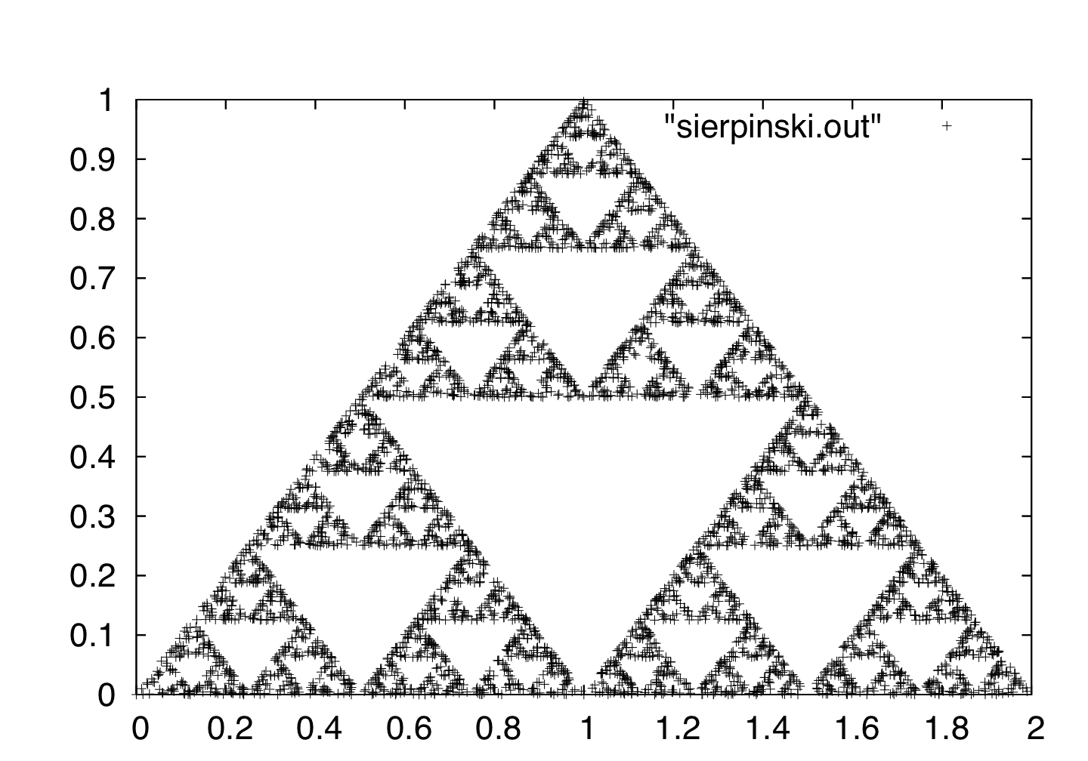
the red is true
origin: Norway
but most other coastlines are ‘self-similar’, too!

Slide 41
the red is true
origin: Norway
but most other coastlines are ‘self-similar’, too!
B. Mandelbrot
math.yale.edu

Slide 42
Q: Fractals and Graphs?

Slide 43
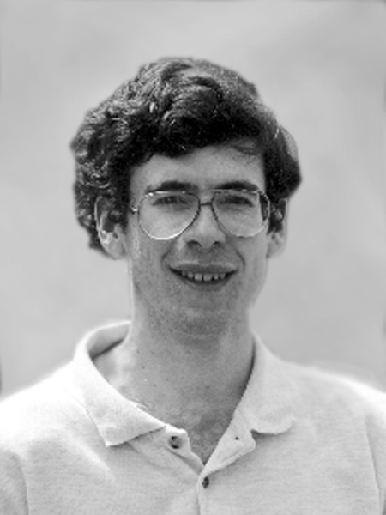
Fractals and Graphs
A: RMAT/Kronecker generators
D. Chakrabarti
J. Leskovec
J. Kleinberg
R-MAT: A Recursive Model for Graph Mining,
by D. Chakrabarti, Y. Zhan and C. Faloutsos,
SDM 2004, Orlando, Florida, USA
Realistic, Mathematically Tractable Graph Generation
and Evolution, Using Kronecker Multiplication,
by J. Leskovec, D. Chakrabarti, J. Kleinberg,
and C. Faloutsos, in PKDD 2005, Porto, Portugal

Slide 44
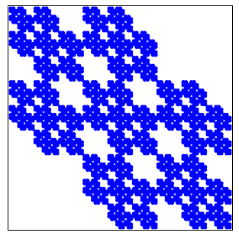
Kronecker Graphs
KDD dissertation award
[J. Leskovec, 2009]
PKDD test of time award, 2015
https://graph500.org/

Slide 45
Examples of models
✓
Fractals / self-similarity (Norway; Kronecker)
Logistic parabola (flies; covid)
Lotka-Volterra
Lorenz attractor (laser / synthetic )
Van der Pol / FitzHugh-Nagumo

Slide 46
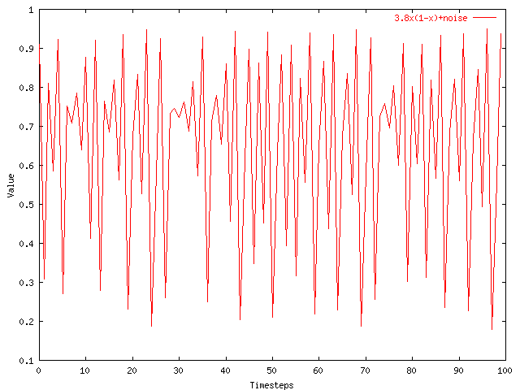
Q3.1) models?
Value
Time

Slide 47

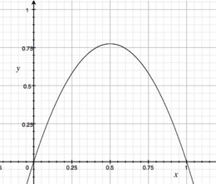
A3.1) Logistic parabola
Models population of flies [R. May/1976]
Logistic map
Time-series plot
Time t
Notes:
x_{t+1} = a x_t \cdot \left( 1-x_t \right )

Slide 48
A3.1) Logistic parabola
royalsociety.org
Models population of flies [R. May/1976]
Logistic map
= SI virus prop. model
~ Bass equation (market penetration)
Special case of Lotka-Volterra
[COVID-19: SIR]
Notes:
x_{t+1} = a x_t \cdot \left( 1-x_t \right )

Slide 49

Q3) How can we find better models?
A3) Domain experts / cross-disciplinarity

Slide 50
Future – parting thoughts
✓
Q1) Definition of anomaly?
A) “… strange/remote/unlikely, wrt our biases/priors”
Q2) can we automate it?
A) no, but: look for better models/biases/priors
Q3) next steps?
A) cross-disciplinarity -> new+better models
✓
✓

Slide 51







Thanks
Disclaimer: All opinions are mine; not necessarily reflecting the opinions of the funding agencies
Thanks to: NSF IIS-0705359, IIS-0534205,
CTA-INARC; Yahoo (M45), LLNL, IBM, SPRINT, Google, INTEL, HP, iLab

Slide 52
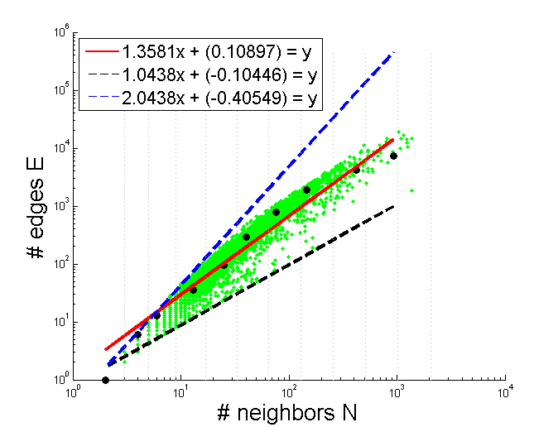
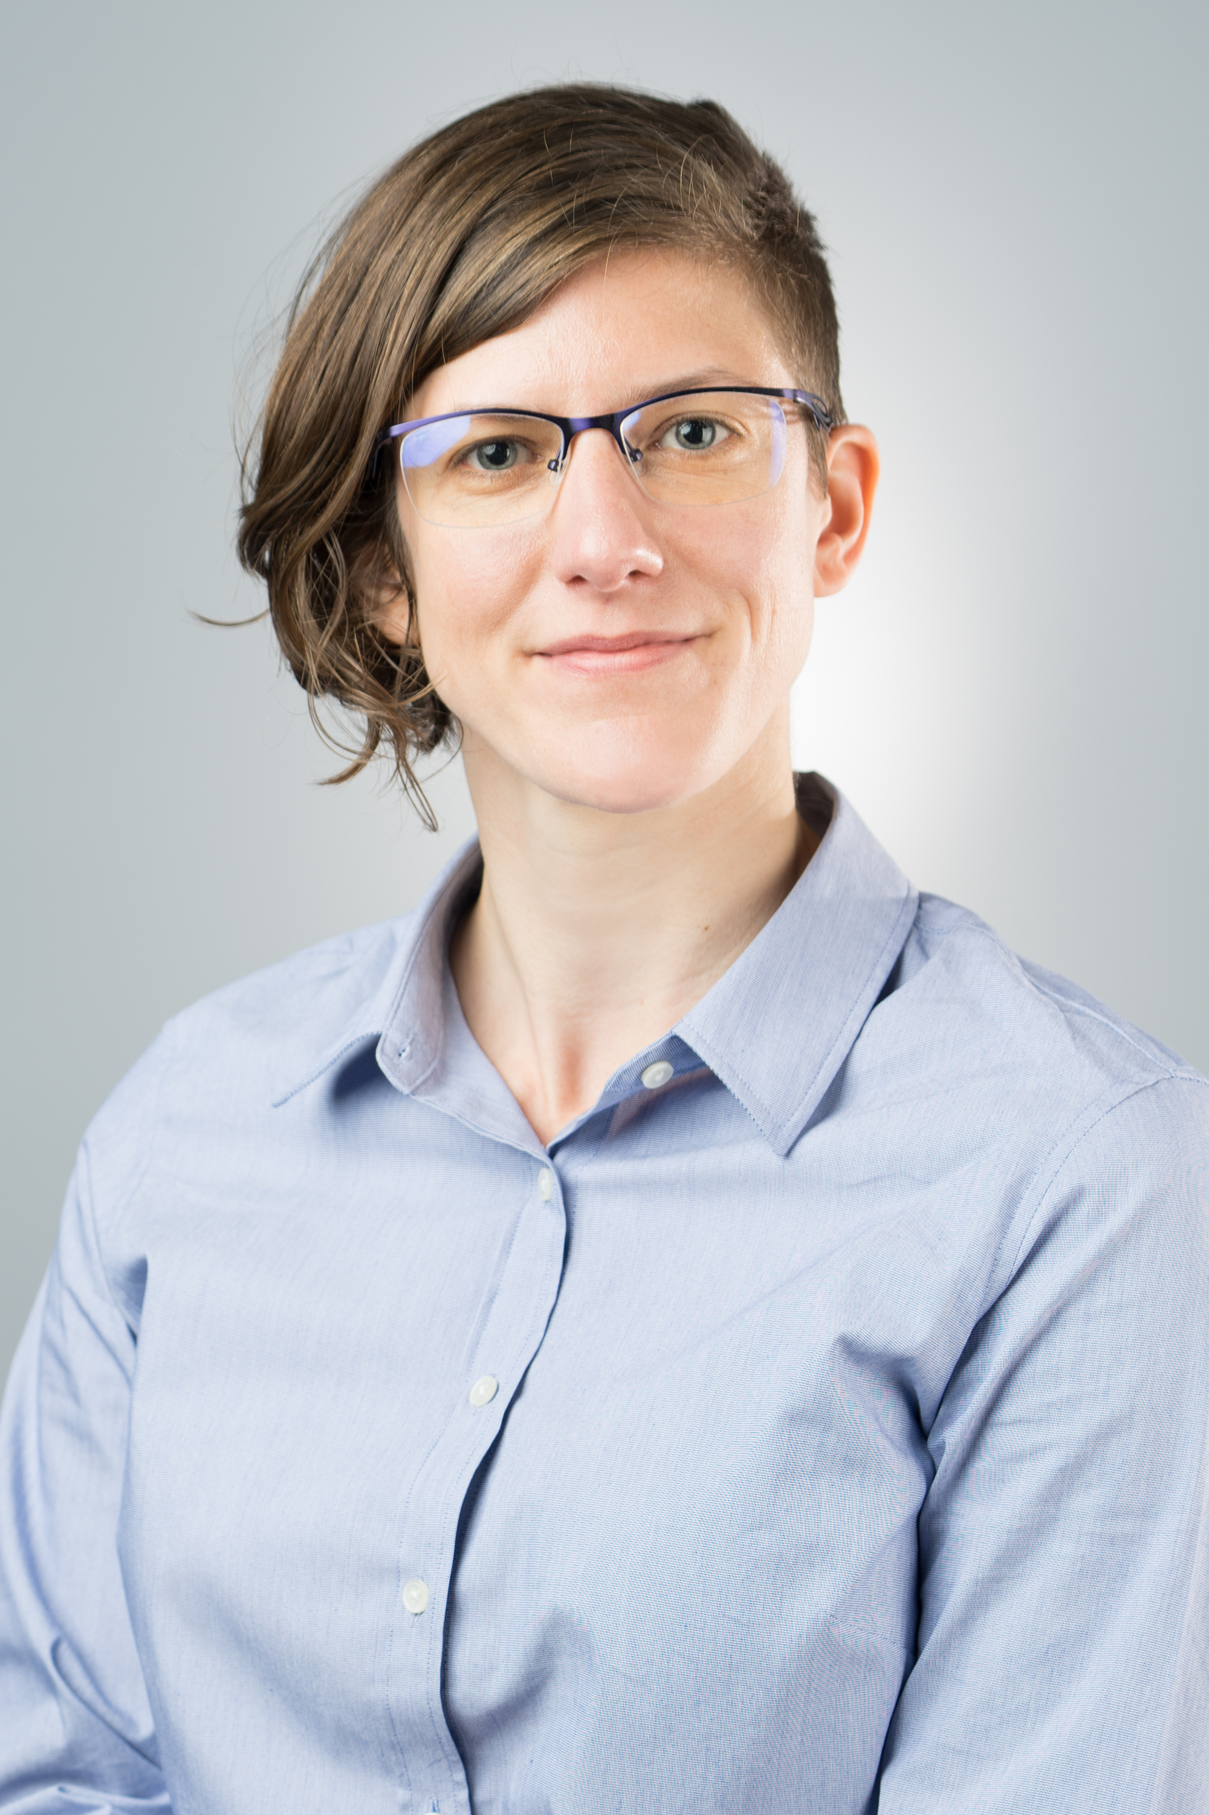
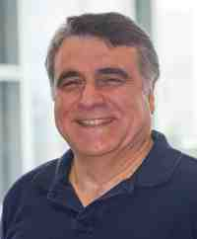
Thank you!

Slide 53
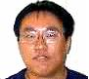
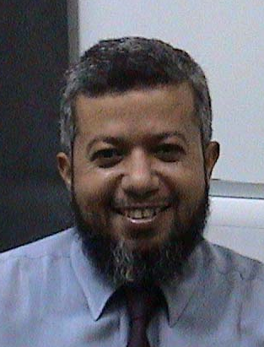
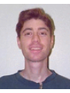
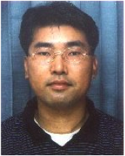
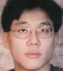
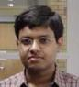
Academic ‘children’
King-Ip (David) Lin
Ibrahim Kamel
Flip Korn
Byoung-Kee Yi
Leejay Wu
Deepayan Chakrabarti

Slide 54
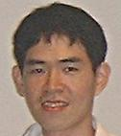
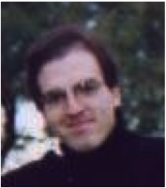
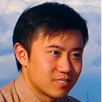
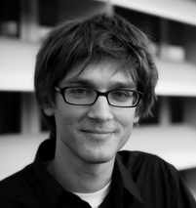
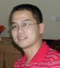
Academic ‘children’
Jia-Yu (Tim) Pan
Spiros Papadimitriou
Jimeng Sun
Jure Leskovec
Hanghang Tong

Slide 55
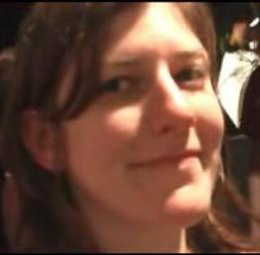
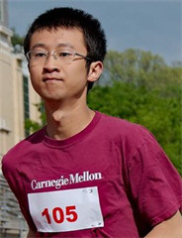
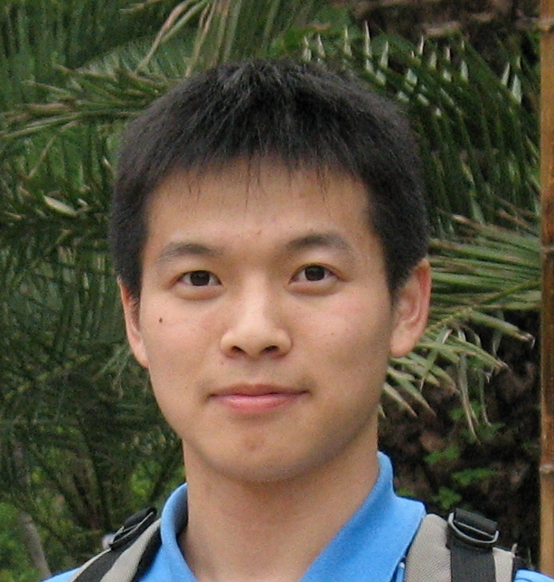
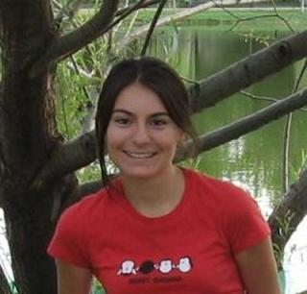

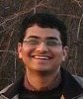
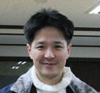
Academic ‘children’
Mary McGlohon
Fan Guo
Lei Li
Leman Akoglu
Dueng Horng (Polo) Chau
Aditya Prakash
U Kang

